Slide 1
Who Needs Geology?

Slide 2
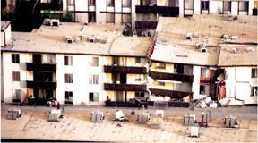
Geology in Today’s World
Geology - The scientific study of the Earth
Physical Geology is the study of Earth’s materials, changes of the surface and interior of the Earth, and the forces that cause those changes
Historical Geology is the of the origin
Practical Aspects of Geology
Natural resources
Geological hazards
Environmental protection

Slide 3
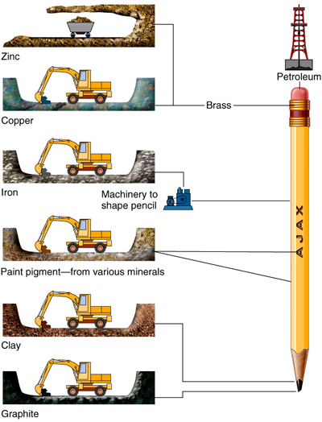
Practical Aspects of Geology
Natural Resources
All manufactured objects depend on Earth’s resources
Localized concentrations of useful geological resources are mined or extracted
If it can’t be grown, it must be mined
Most resources are limited in quantity and non-renewable

Slide 4
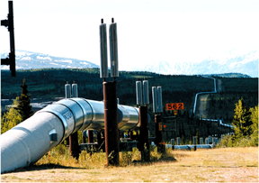
Resource Extraction and Environmental Protection
Coal Mining
Careless mining can release acids into groundwater
Petroleum Resources
Removal, transportation and waste disposal can damage the environment
Alaska pipeline
Dwindling resources can encourage disregard for
ecological damage caused by extraction activities

Slide 5
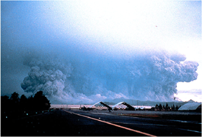
Geologic Hazards
Earthquakes
Shaking can damage buildings and break utility lines (electric, gas, water, sewer)
Volcanoes
Ash flows and mudflows can overwhelm populated areas
Landslides, floods, and wave erosion

Slide 6
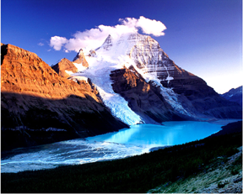
Physical Geology Concepts
Earth’s Systems
Atmosphere
the gases that envelop the Earth
Hydrosphere
water on or near the Earth’s surface
Biosphere
all living or once-living materials
Geosphere
the solid rocky Earth

Slide 7
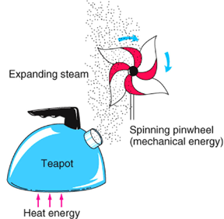
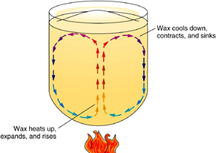
Physical Geology Concepts
Earth’s Heat Engines
External (energy from the Sun)
Primary driver of atmospheric (weather) and hydrospheric circulation
Controls weathering of rocks at Earth’s surface
Internal (heat moving from hot interior to cooler exterior)
Primary driver of most geospheric phenomena (volcanism, magmatism, tectonism)

Slide 8
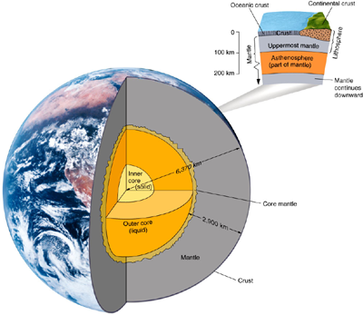
Earth’s Interior
Compositional Layers
Crust (~3-70 km thick)
Very thin outer rocky shell of Earth
Continental crust - thicker and less dense
Oceanic crust - thinner and more dense
Mantle (~2900 km thick)
Hot solid that flows slowly over time; Fe-, Mg-, Si-rich minerals
Core (~3400 km radius)
Outer core - metallic liquid;
mostly iron
Inner core - metallic solid; mostly iron

Slide 9
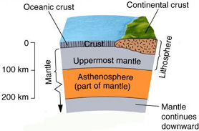
Earth’s Interior
Mechanical Layers
Lithosphere (~100 km thick)
Rigid/brittle outer shell of Earth
Composed of both crust and uppermost mantle
Makes up Earth’s tectonic “plates”
Asthenosphere
Plastic (capable of flow) zone on which the lithosphere “floats”

Slide 10
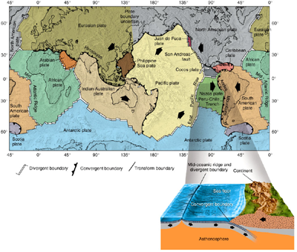
Theory of Plate Tectonics
Continental Drift Hypothesis
Originally proposed in early 20th century to explain the “fit of continents”, common rock types and fossils across ocean basins, etc.
Insufficient evidence found for driving mechanism; hypothesis initially rejected
Plate Tectonics Theory
Originally proposed in the late 1960s
Included new understanding of the seafloor and explanation of driving force
Describes lithosphere as being broken into plates that are in motion
Explains origin and locations of such things as volcanoes, fault zones and mountain belts

Slide 11
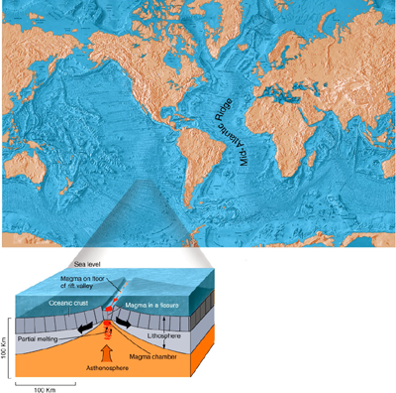
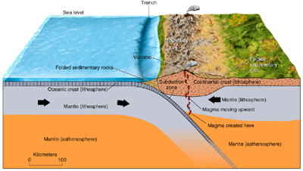
Tectonic Plate Boundaries
Divergent boundaries
Plates move apart
Magma rises, cools and forms new lithosphere
Typically expressed as mid-oceanic ridges
Transform boundaries
Plates slide past one another
Fault zones and earthquakes mark boundary
San Andreas fault in California
Convergent boundaries
Plates move toward each other
Mountain belts and volcanoes common
Oceanic plates may sink into mantle along a subduction zone, typically marked by a deep ocean trench

Slide 12
Geologic Time
“Deep” Time
Most geologic processes occur gradually over millions of years
Changes typically imperceptible over the span of a human lifetime
Current best estimate for age of Earth is ~4.55 billion years
Geologic Time and the History of Life
Complex life forms became abundant ~544 million years ago
Reptiles became abundant ~230 million years ago
Dinosaurs became extinct (along with many other organisms)
~65 million years ago
Humans have been around for only ~ 3 million years
“Nothing hurries geology”
Mark Twain

Slide 13
Geologic time
Geologists are now able to assign fairly accurate dates to events in Earth history
Relative dating and the geologic time scale
Relative dating means that dates are placed in their proper sequence or order without knowing their age in years

Slide 14
Geologic time
The magnitude of geologic time
Involves vast times – millions or billions of years
An appreciation for the magnitude of geologic time is important because many processes are very gradual

Slide 15
The
Geologic
Time
Scale
Figure 1.4

